Slide 1
AI-Driven System for Classifying Skin Diseases from Images
Team 7
Notes:
Damian- 1,2,3,5,6 Madz- 7,8 Manny-9,10 Sri-6,11 Sav-12,13,14

Slide 2

Team Members
Project Advisor
Project Sponsor
Dr. Hajiarbabi
Damian Williams - Team Lead
Srinithi Yalamanchili
Maddie Sidwell
Manuel Nieves Garcia
Savannah Ostermeyer
Dr. Hajiarbabi

Slide 3
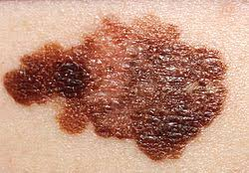
Problem Statement
Melanoma is one of the deadliest skin cancers
Around 8,000 people die from melanoma each year
The mortality rate for melanoma is highest among older adults and those with advanced-stage disease
Notes:
Early detection of melanoma increases the survival rates

Slide 4

Proposed Solution
Early detection increases survival rates.
Quickly diagnosing and providing information to medical professional and patients
Notes:
Early detection of melanoma increases the survival rates

Slide 5

Proposed Overview
Developing a convolutional neural network (CNN)-based system to classify skin diseases.
Users can upload images of skin lesions and receive rapid feedback.
Ai expert to simulate medical screening
Notes:
Early detection of melanoma increases the survival rates

Slide 6

Expected Deliverable System
Trained model and web interface
Final report with dataset analysis and limitations
Presentation/demo session

Slide 7
Requirements
Collect demographics, symptom descriptions, and allow users to upload lesion images.
Store medical rules, disease information, and apply reasoning or machine learning to support differential diagnosis with confidence scores.
Present possible diagnoses, next steps, and red-flag alerts, while generating patient reports and storing diagnostic history.
Integrate new knowledge and retrain models on updated datasets.
Notes:
Functional

Slide 8

Requirements
Intuitive interface for patients and dermatologists, accessible via web or mobile
Achieve ≥85–90% classification accuracy and generate diagnoses within seconds, handling multiple inputs efficiently
Ensure HIPAA/GDPR-compliant secure data handling and provide explanations highlighting key features of the diagnosis.
Notes:
Non-Functional

Slide 9
Optional Requirements
Multilingual support: Add multiple language options for wider accessibility.
User account system: Allow patients and dermatologists to create accounts for uploading and saving cases.
Longitudinal tracking: This provides graphs that show how a lesion evolves over multiple uploads.
Telehealth API Integration: Connect with telehealth services for direct dermatologist consultation.

Slide 10
Optional Requirements
Risk assessment dashboard: Summarize risk factors (e.g., family history, sun exposure) alongside AI diagnosis.
Offline capability: Allow the mobile app to run basic inference without internet access.
Expanded disease set: Add rarer or systemic conditions beyond the initial dataset scope.
Advanced explainability: Provide interactive heatmaps or feature-importance charts beyond Grad-CAM

Slide 11

Challenges
Various image sizes
Variations in image quality
Similarities in patterns of skin diseases
Categorizing stages in skin diseases
Scheduling Conflicts
Other Class Projects
Finding up to date research and data

Slide 12
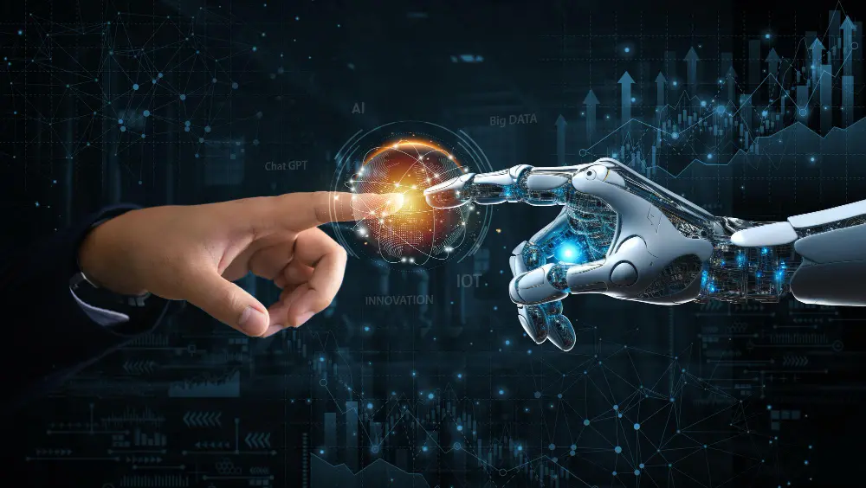
Technology
Visual Studio Code - IDE
GitHub - Version control
Git
PyTorch
Deep learning framework to build and train our CNN
ResNet50
Pre-trained CNN model architecture for image recognition
HAM10000
Public dataset of dermoscopic images sorted into 7 categories

Slide 13

Project Development Plan
Set up our environment
Prepare the dataset
Build the CNN model
Train the Model
Evaluate the model
Deployment
Notes:
Install python, pytorch, and all necessary libraries
Download HAM10000 dataset and preprocess the images. Then split into train, validation and test sets
Import pretrained resnet50
Replace the final classification layer with a layer matching the number of skin disease classes (7 for HAM10000)
Freeze earlier layers ito fine tune the whole network for better performance
Train the model
Define loss function and optimizer
Training loop
Validate after each epoch
Evaluate the model
Test on the held out test set
Measure metrics
Visualize predictions vs true labels
Deployment
Package the model into an API
Deploy to a web app

Slide 14
End Goal
Develop an AI-driven system capable of accurately classifying common skin diseases from medical images.
Provide a user-friendly interface for patients and dermatologists to test images and receive diagnostic support.
Deliver a robust, explainable model with performance metrics that meet medical standards.
Enable decision support with actionable recommendations and risk alerts for urgent conditions.
Create a foundation for continuous learning, allowing integration of new medical knowledge and updated datasets.

Slide 15
Questions?

